Slide 1

Introduction to Neural Networks
About this Course
deeplearning.ai

Slide 2
Outline of this Course
Week 1: Introduction
Week 2: Basics of Neural Network programming
Week 3: One hidden layer Neural Networks
Week 4: Deep Neural Networks

Slide 3
Outline of this Course
Week 1: Introduction
Week 2: Basics of Neural Network programming
Week 3: One hidden layer Neural Networks
Week 4: Deep Neural Networks

Slide 4
Introduction to Deep Learning
What is a
Neural Network?
deeplearning.ai

Slide 5
Housing Price Prediction
price
size of house

Slide 6
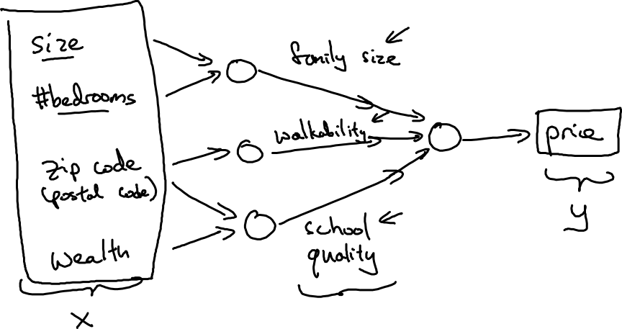
Housing Price Prediction

Slide 7
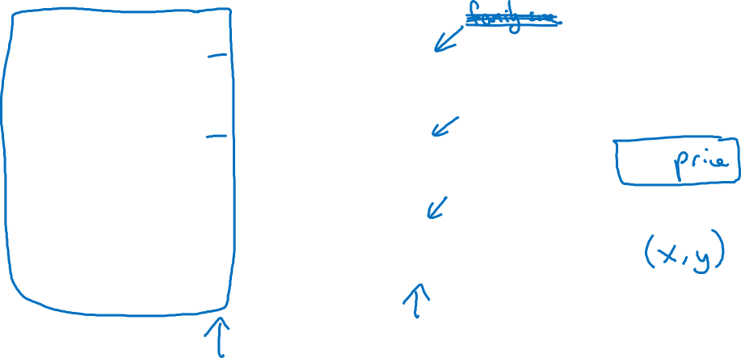
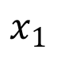
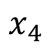
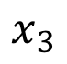
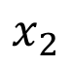
Housing Price Prediction
size
$$x_{1}$$
#bedrooms
$$x_{2}$$
y
zip code
$$x_{3}$$
wealth
$$x_{4}$$

Slide 8
Introduction to Deep Learning
Supervised Learning
with Neural Networks
deeplearning.ai

Slide 9
Supervised Learning
Input(x)
Output (y)
Application
Home features
Price
Real Estate
Ad, user info
Click on ad? (0/1)
Online Advertising
Image
Object (1,…,1000)
Photo tagging
Audio
Text transcript
Speech recognition
English
Chinese
Machine translation
Image, Radar info
Position of other cars
Autonomous driving

Slide 10
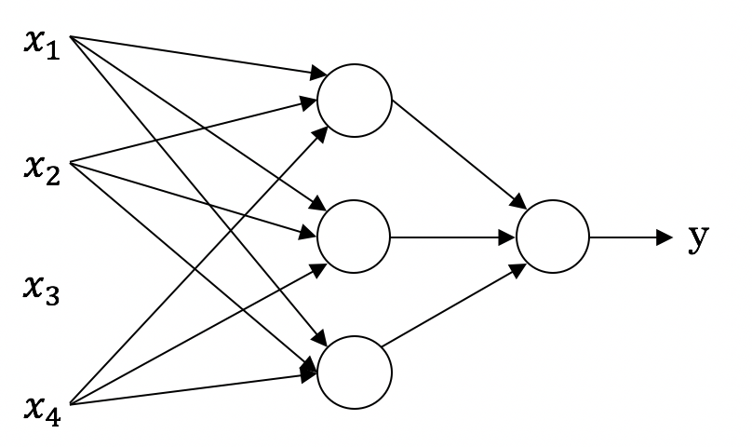
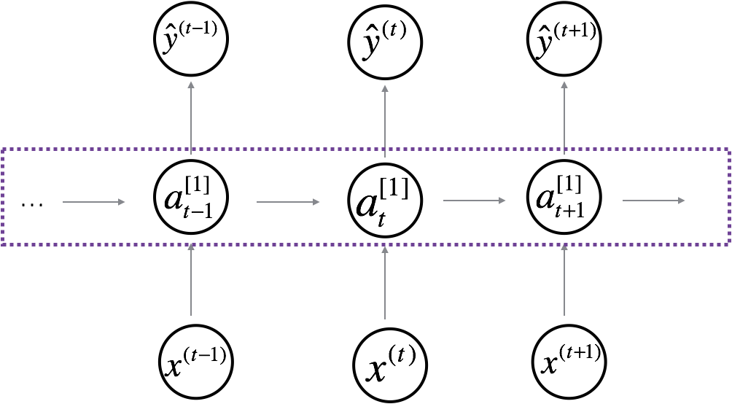
Neural Network examples
Standard NN
Convolutional NN
Recurrent NN

Slide 11

Supervised Learning
Structured Data
Unstructured Data
Size | #bedrooms | … | Price (1000$s)
2104 1600 2400 ⋮ 3000 | 3 3 3 ⋮ 4 |  | 400 330 369 ⋮ 540
Audio
Image
User Age | Ad Id | … | Click
41 80 18 ⋮ 27 | 93242 93287 87312 ⋮ 71244 |  | 1 0 1 ⋮ 1
Four scores and seven years ago…
Text

Slide 12
Introduction to Neural Networks
Why is Deep Learning taking off?
deeplearning.ai

Slide 13
Scale drives deep learning progress
Performance
Amount of data

Slide 14

Scale drives deep learning progress
Idea
Data
Computation
Algorithms
Experiment
Code

Slide 15
Outline of this Course
Week 1: Introduction
Week 2: Basics of Neural Network programming
Week 3: One hidden layer Neural Networks
Week 4: Deep Neural Networks

Slide 16
Basics of Neural Network Programming
Binary Classification
deeplearning.ai

Slide 17
Binary Classification
1 (cat) vs 0 (non cat)
Blue
Green
Red

Slide 18
Notation

Slide 19
Basics of Neural Network Programming
Logistic Regression
deeplearning.ai

Slide 20
Logistic Regression

Slide 21
Basics of Neural Network Programming
Logistic Regression
cost function
deeplearning.ai

Slide 22
Logistic Regression cost function
$\hat{y} = σ\left(w^{T}x +b\right)$, where $σ\left(z \right)=\frac{1}{1+e^{−z}}$
Given $\left\{{(x}^{(1)},y^{(1)}\text{)}\text{,}\text{…}\text{,}{(x}^{(m)},y^{(m)}\text{)}\right\},$want ${\hat{y}}^{(i)}≈y^{\left(i\right)}$.
Loss (error) function:

Slide 23
Basics of Neural Network Programming
Gradient Descent
deeplearning.ai

Slide 24
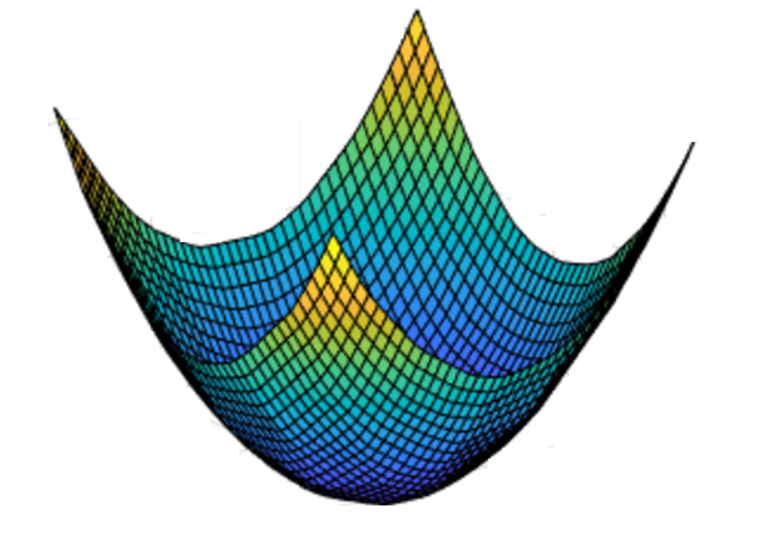
Gradient Descent
Recap: $\hat{y}= σ\left(w^{T}x+b\right)$, $σ\left(z\right)=\frac{1}{1+e^{−z}}$
$$\frac{1}{m}\sum_{i=1}^{m}{ }$$
$ℒ({\hat{y}}^{\left(i\right)},y^{(i)})$ $=$
$$−\frac{1}{m}\sum_{i=1}^{m}{ }$$
$$J\left(w,b\right)=$$
$y^{(i)}\log{{\hat{y}}^{\left(i\right)}}$+ $({1−y}^{(i)})\log{(1 −{\hat{y}}^{\left(i\right)})}$
Want to find $w,b$ that minimize $J\left(w,b\right)$
$$J\left(w,b\right)$$
$$b$$
$$w$$

Slide 25
Gradient Descent
$$w$$

Slide 26
Basics of Neural Network Programming
Derivatives
deeplearning.ai

Slide 27
Intuition about derivatives
$$f\left(a\right)=3a$$
$$a$$

Slide 28
Basics of Neural Network Programming
More derivatives examples
deeplearning.ai

Slide 29
Intuition about derivatives
$$f\left(a\right)=a^{2}$$
$$a$$

Slide 30
Basics of Neural Network Programming
Computation Graph
deeplearning.ai

Slide 31
Computation Graph

Slide 32
Basics of Neural Network Programming
Derivatives with a Computation Graph
deeplearning.ai

Slide 33
Computing derivatives
$$a=5$$
11
33
$$b=3$$
6
$$v=a+u$$
$J=3v$
$u$=$bc$
$$c=2$$

Slide 34
Computing derivatives
$$a=5$$
11
33
$$b=3$$
6
$$v=a+u$$
$J=3v$
$u$=$bc$
$$c=2$$

Slide 35
Basics of Neural Network Programming
Logistic Regression
Gradient descent
deeplearning.ai

Slide 36
Logistic regression recap
$$z= w^{T}x+b$$
$$\hat{y}=a= σ(z)$$
$$ℒ\left(a,y\right)=−(y\log{(a)+(1−y)\log{(1−a))}}$$

Slide 37
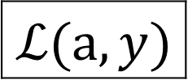
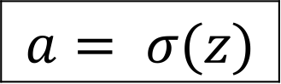
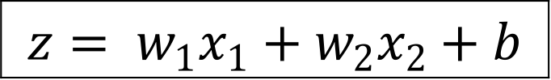
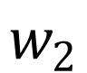
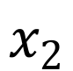
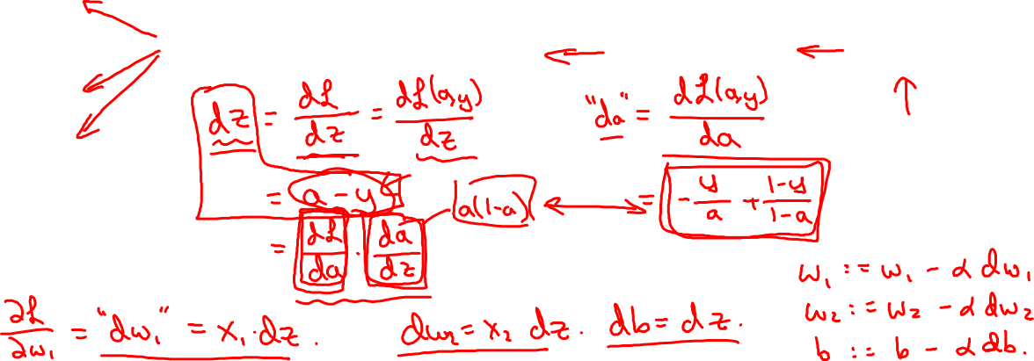
Logistic regression derivatives
$$x_{1}$$
$$w_{1}$$
$$x_{2}$$
$$z= w_{1}x_{1}+w_{2}x_{2}+b$$
$$a= σ(z)$$
$$ℒ(a,y)$$
$$w_{2}$$
b

Slide 38
Basics of Neural Network Programming
Gradient descent
on m examples
deeplearning.ai

Slide 39
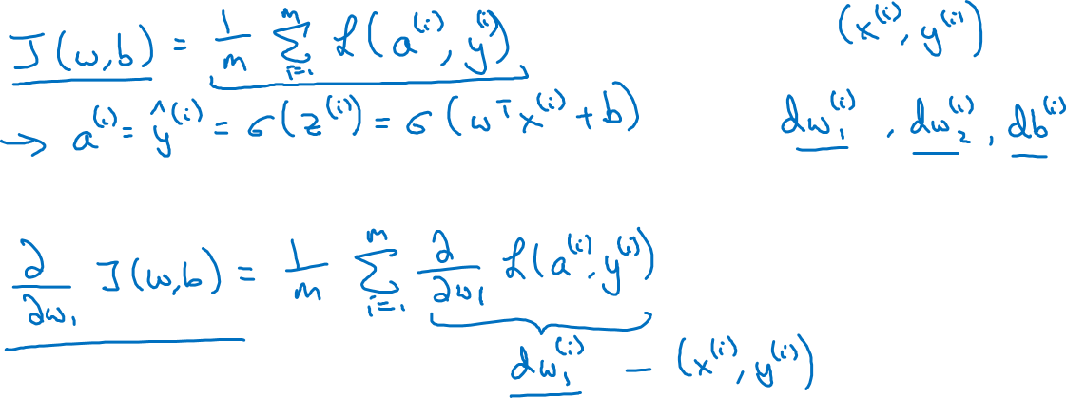
Logistic regression on m examples

Slide 40
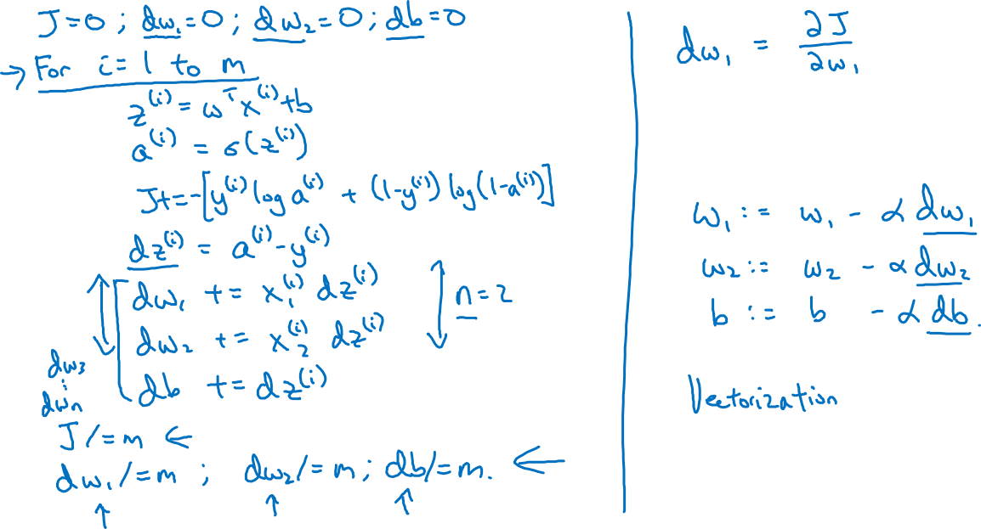
Logistic regression on m examples

Slide 41
Basics of Neural Network Programming
Vectorizing Logistic
Regression
deeplearning.ai

Slide 42
Vectorizing Logistic Regression
$$z^{(1)}=w^{T}x^{(1)}+b$$
$$z^{(2)}=w^{T}x^{(2)}+b$$
$$z^{(3)}=w^{T}x^{(3)}+b$$
$$a^{(1)}={σ(z}^{(1)})$$
$$a^{(2)}={σ(z}^{(2)})$$
$$a^{(3)}={σ(z}^{(3)})$$

Slide 43
Basics of Neural Network Programming
Vectorizing Logistic
Regression’s Gradient
Computation
deeplearning.ai

Slide 44
Vectorizing Logistic Regression

Slide 45
Implementing Logistic Regression
J = 0, d$w_{1}$ = 0, d$w_{2}$ = 0, db = 0
for i = 1 to m:
$z^{(i)}$ = $w^{T}x^{(i)}+b$
$a^{(i)}$ = $σ{(z}^{(i)})$
$J$+= $−\left[y^{(i)} \log{a^{\left(i\right)}+({1−y}^{\left(i\right)})\log{(1 −a^{\left(i\right)})}}\right]$
d$z^{(i)}$ = $a^{(i)}{−y}^{(i)}$
d${w_{1}}^{ }$+= $x_{1}^{(i)}\text{d}z^{(i)}$
d${w_{2}}^{ }$+= $x_{2}^{(i)}\text{d}z^{(i)}$
db += d$z^{(i)}$
J = J/m, d$w_{1}$ = d$w_{1}$/m, d$w_{2}$ = d$w_{2}$/m
db = db/m

Slide 46
Basics of Neural Network Programming
Broadcasting in
Python
deeplearning.ai

Slide 47
Broadcasting example
$$\left[\begin{matrix}1 \\ \begin{aligned}\begin{matrix}2 \\ 3\end{matrix} \\ 4\end{aligned}\end{matrix}\right]$$
$$\left[\begin{matrix}101 \\ \begin{aligned}\begin{matrix}102 \\ 103\end{matrix} \\ 104\end{aligned}\end{matrix}\right]$$
$$100$$
=
+
$\left[\begin{matrix}1 & 2 & 3 \\ 4 & 5 & 6\end{matrix}\right]$
$$\left[\begin{matrix}100 & 200 & 300\end{matrix}\right]$$
$$\left[\begin{matrix}101 & 202 & 303 \\ 104 & 205 & 306\end{matrix}\right]$$
+
=
$\left[\begin{matrix}1 & 2 & 3 \\ 4 & 5 & 6\end{matrix}\right]$
$$\left[\begin{matrix}100 \\ 200\end{matrix}\right]$$
$$\left[\begin{matrix}101 & 102 & 103 \\ 204 & 205 & 206\end{matrix}\right]$$
+
=

Slide 48
Outline of this Course
Week 1: Introduction
Week 2: Basics of Neural Network programming
Week 3: One hidden layer Neural Networks
Week 4: Deep Neural Networks

Slide 49
One hidden layer
Neural Network
Neural Networks
Overview

Slide 50
What is a Neural Network?
$$x_{1}$$
$$x_{2}$$
$$\hat{y}$$
$$x_{3}$$
x
w
$$z=w^{T}x+b$$
$$a=σ(z)$$
$$ℒ(a,y)$$
b
$$x_{1}$$
$$x_{2}$$
$$\hat{y}$$
$$x_{3}$$
x
$$W^{[1]}$$
$$z^{[1]}=W^{[1]}x+b^{[1]}$$
$$a^{[1]}=σ(z^{[1]})$$
$$z^{[2]}=W^{[2]}a_{ }^{[1]}+b^{[2]}$$
$$a^{[2]}=σ(z^{[2]})$$
$$ℒ(a^{[2]},y)$$
$$b^{[1]}$$
$$W^{[2]}$$
$$b^{[2]}$$

Slide 51
One hidden layer
Neural Network
Neural Network
Representation

Slide 52
Neural Network Representation
$$x_{1}$$
$$x_{2}$$
$$\hat{y}$$
$$x_{3}$$

Slide 53
One hidden layer
Neural Network
Computing a
Neural Network’s
Output

Slide 54
Neural Network Representation
$$x_{1}$$
$$x_{1}$$
$$x_{2}$$
$$σ(z)$$
$$a=\hat{y}$$
$$x_{2}$$
$$\hat{y}$$
$$w^{T}x+b$$
$$z$$
$$a$$
$$x_{3}$$
$$x_{3}$$
$$z=w^{T}x+b$$
$$a=σ(z)$$

Slide 55
Neural Network Representation
$$x_{1}$$
$$x_{1}$$
$$x_{2}$$
$$σ(z)$$
$$a=\hat{y}$$
$$x_{2}$$
$$\hat{y}$$
$$w^{T}x+b$$
$$z$$
$$a$$
$$x_{3}$$
$$x_{3}$$
$$z=w^{T}x+b$$
$$x_{1}$$
$$a=σ(z)$$
$$x_{2}$$
$$\hat{y}$$
$$x_{3}$$

Slide 56
Neural Network Representation
$$a_{1}^{\left[1\right]}$$
$z_{1}^{\left[1\right]}=w_{1}^{{\left[1\right]T}^{ }}x+b_{1}^{[1]}, a_{ 1}^{[1]}=σ(z_{1}^{\left[1\right]}$)
$$x_{1}$$
$$a_{2}^{\left[1\right]}$$
$z_{2}^{\left[1\right]}=w_{2}^{{\left[1\right]T}^{ }}x+b_{2}^{[1]}, a_{ 2}^{[1]}=σ(z_{2}^{\left[1\right]}$)
$$x_{2}$$
$$\hat{y}$$
$$a_{3}^{\left[1\right]}$$
$z_{3}^{\left[1\right]}=w_{3}^{{\left[1\right]T}^{ }}x+b_{3}^{[1]}, a_{ 3}^{[1]}=σ(z_{3}^{\left[1\right]}$)
$$x_{3}$$
$$a_{4}^{\left[1\right]}$$
$z_{4}^{\left[1\right]}=w_{4}^{{\left[1\right]T}^{ }}x+b_{4}^{[1]}, a_{ 4}^{[1]}=σ(z_{4}^{\left[1\right]}$)

Slide 57
Neural Network Representation learning
$$a_{1}^{\left[1\right]}$$
Given input x:
$$x_{1}$$
$$a_{2}^{\left[1\right]}$$
$$z^{\left[1\right]}=W^{\left[1\right]}x+b^{\left[1\right]}$$
$$x_{2}$$
$$\hat{y}$$
$$a_{3}^{\left[1\right]}$$
$$x_{3}$$
$$a^{\left[1\right]}=σ(z^{\left[1\right]})$$
$$a_{4}^{\left[1\right]}$$
$$z^{\left[2\right]}=W^{\left[2\right]}a^{\left[1\right]}+b^{\left[2\right]}$$
$$a^{\left[2\right]}=σ(z^{\left[2\right]})$$

Slide 58
One hidden layer
Neural Network
Vectorizing across
multiple examples

Slide 59
Vectorizing across multiple examples
$$z^{\left[1\right]}=W^{\left[1\right]}x+b^{\left[1\right]}$$
$$x_{1}$$
$$a^{\left[1\right]}=σ(z^{\left[1\right]})$$
$$x_{2}$$
$$\hat{y}$$
$$z^{\left[2\right]}=W^{\left[2\right]}a^{\left[1\right]}+b^{\left[2\right]}$$
$$x_{3}$$
$$a^{\left[2\right]}=σ(z^{\left[2\right]})$$

Slide 60
Vectorizing across multiple examples
for i = 1 to m:
$$z^{\left[1\right](i)}=W^{\left[1\right]}x^{(i)}+b^{\left[1\right]}$$
$$a^{\left[1\right](i)}=σ(z^{\left[1\right]\left(i\right)})$$
$$z^{\left[2\right](i)}=W^{\left[2\right]}a^{\left[1\right](i)}+b^{\left[2\right]}$$
$$a^{\left[2\right](i)}=σ(z^{\left[2\right]\left(i\right)})$$

Slide 61
One hidden layer
Neural Network
Explanation
for vectorized
implementation

Slide 62
Justification for vectorized implementation

Slide 63
Recap of vectorizing across multiple examples
for i = 1 to m
$$x_{1}$$
$$z^{\left[1\right](i)}=W^{\left[1\right]}x^{(i)}+b^{\left[1\right]}$$
$$x_{2}$$
$$\hat{y}$$
$$x_{3}$$
$$a^{\left[1\right](i)}=σ(z^{\left[1\right]\left(i\right)})$$
$$z^{\left[2\right](i)}=W^{\left[2\right]}a^{\left[1\right](i)}+b^{\left[2\right]}$$
$$a^{\left[2\right](i)}=σ(z^{\left[2\right]\left(i\right)})$$
$$X=$$
$$x^{(1)}$$
$$x^{(2)}$$
…
$$x^{(m)}$$
$$Z^{\left[1\right]}=W^{\left[1\right]}X+b^{\left[1\right]}$$
$$A^{\left[1\right]}=σ(Z^{\left[1\right]})$$
$$Z^{\left[2\right]}=W^{\left[2\right]}A^{\left[1\right]}+b^{\left[2\right]}$$
$A^{[1]}=$
$$a^{[1](1)}$$
$$a^{[1](2)}$$
$$a^{[1](m)}$$
…
$$A^{\left[2\right]}=σ(Z^{\left[2\right]})$$

Slide 64
One hidden layer
Neural Network
Activation functions

Slide 65
Activation functions
$$x_{1}$$
$$x_{2}$$
$$\hat{y}$$
$$x_{3}$$
Given x:
$$z^{\left[1\right]}=W^{\left[1\right]}x+b^{\left[1\right]}$$
$$a^{\left[1\right]}=σ(z^{\left[1\right]})$$
$$z^{\left[2\right]}=W^{\left[2\right]}a^{\left[1\right]}+b^{\left[2\right]}$$
$$a^{\left[2\right]}=σ(z^{\left[2\right]})$$

Slide 66

Pros and cons of activation functions
a
a
x
z
$$a= \frac{1}{1+e^{−z}}$$
sigmoid:
a
a
z
z

Slide 67
One hidden layer
Neural Network
Derivatives of
activation functions

Slide 68
Sigmoid activation function
a
$$g(z)= \frac{1}{1+e^{−z}}$$
z

Slide 69
Tanh activation function
a
$$g(z)=tanh(z){ }$$
z

Slide 70
ReLU and Leaky ReLU
a
a
z
z
ReLU
Leaky ReLU

Slide 71
One hidden layer
Neural Network
Gradient descent for
neural networks

Slide 72
Gradient descent for neural networks

Slide 73
Summary of gradient descent
$$dz^{[2]}=a^{[2]}−y$$
$$dZ^{[2]}=A^{[2]}−Y$$
$$dW^{[2]}=dz^{[2]}a^{{\left[1\right]}^{T}}$$
$$dW^{[2]}=\frac{1}{m}dZ^{[2]}A^{{\left[1\right]}^{T}}$$
$$db^{[2]}=dz^{[2]}$$
$$db^{[2]}=\frac{1}{m}np.sum(dZ^{\left[2\right]},axis=1, keepdims=True)$$
$$dz^{[1]}=W^{\left[2\right]T}dz^{[2]}∗g^{[1]}′(z^{\left[1\right]})$$
$$dZ^{[1]}=W^{\left[2\right]T}dZ^{[2]}∗g^{[1]}′(Z^{\left[1\right]})$$
$$dW^{[1]}=dz^{[1]}x^{T}$$
$$dW^{[1]}=\frac{1}{m}dZ^{[1]}X^{T}$$
$$db^{[1]}=dz^{[1]}$$
$$db^{[1]}=\frac{1}{m}np.sum(dZ^{\left[1\right]},axis=1, keepdims=True)$$

Slide 74
Outline of this Course
Week 1: Introduction
Week 2: Basics of Neural Network programming
Week 3: One hidden layer Neural Networks
Week 4: Deep Neural Networks

Slide 75
Deep Neural Networks
Deep L-layer
Neural network

Slide 76
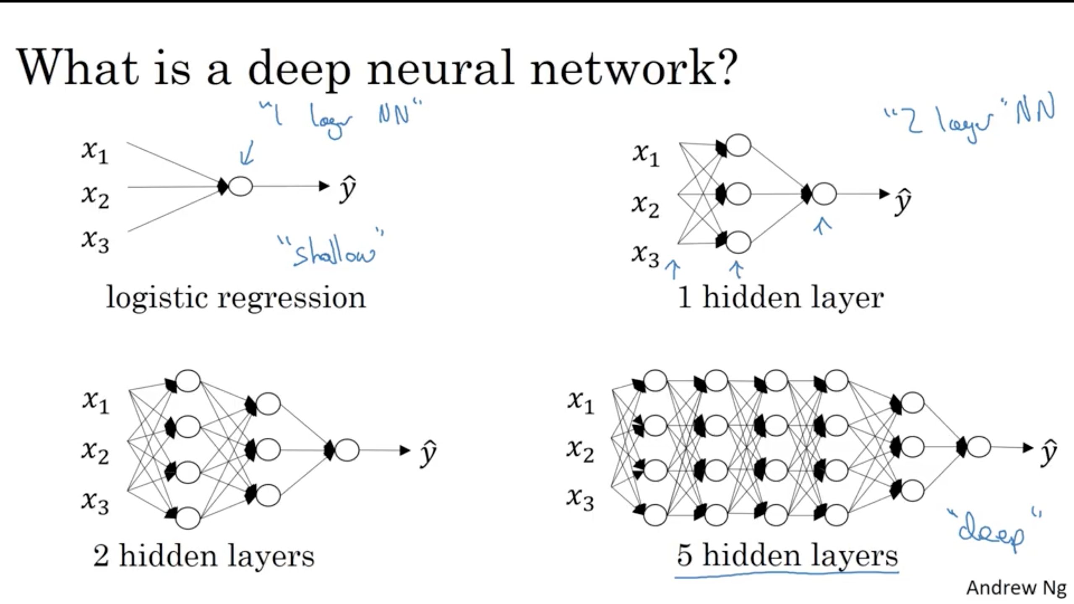

Slide 77
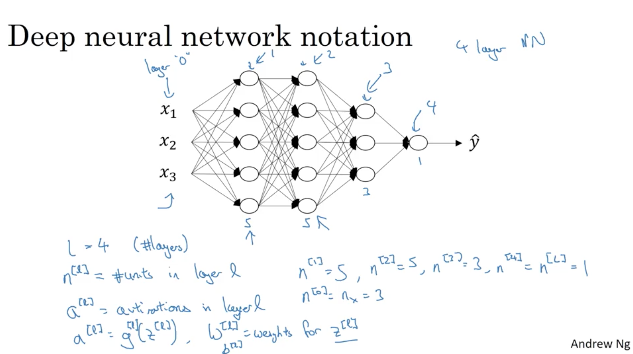

Slide 78
Deep Neural Networks
Forward Propagation
in a Deep Network

Slide 79
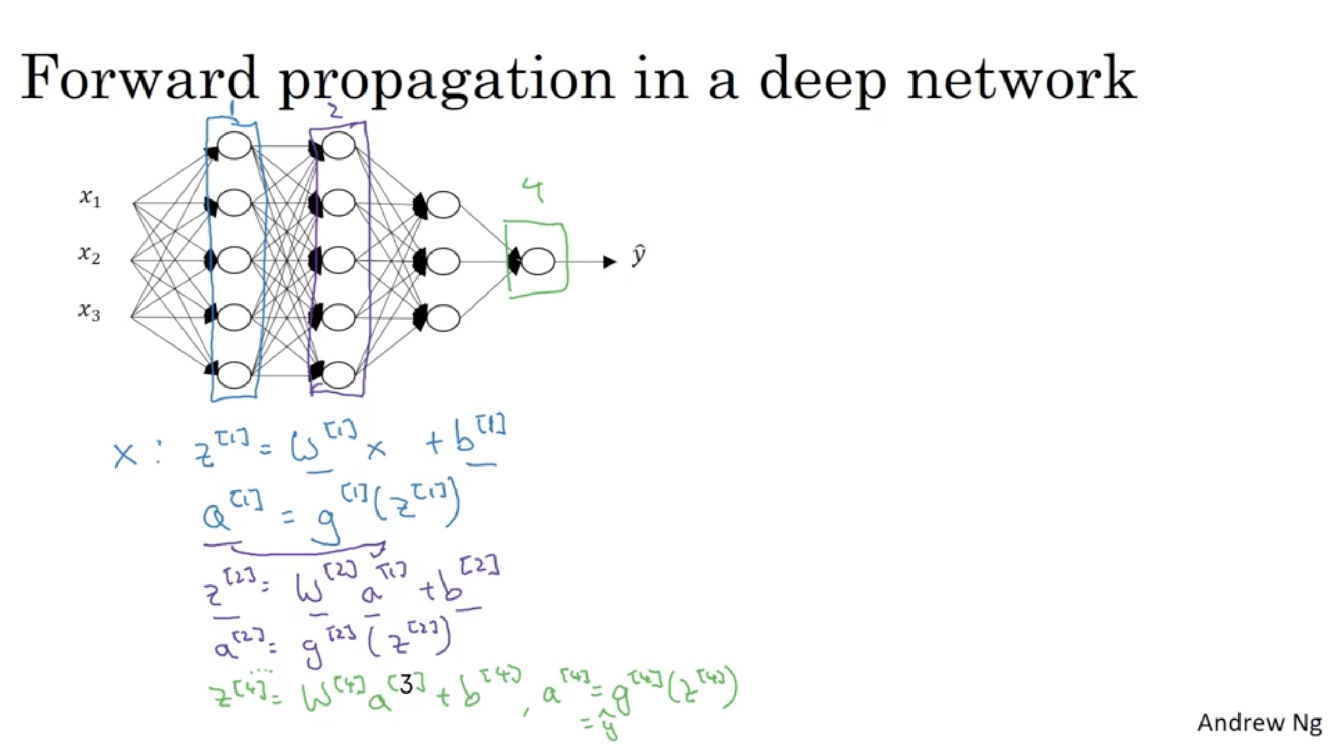

Slide 80
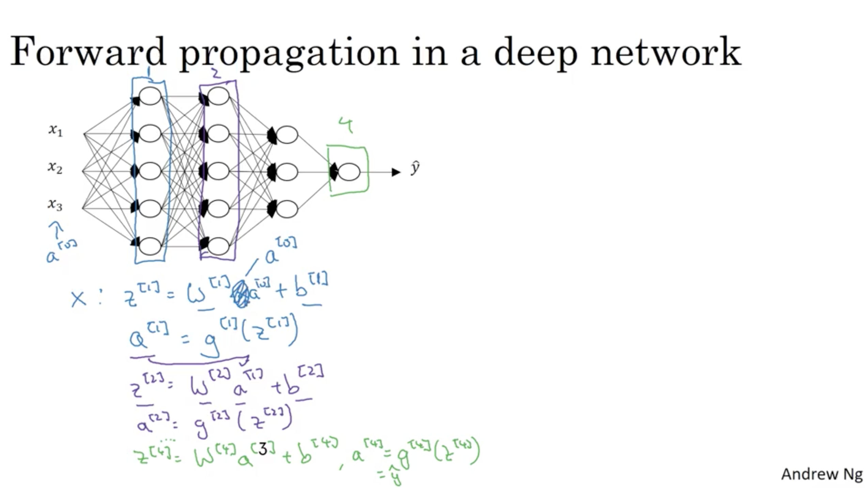

Slide 81
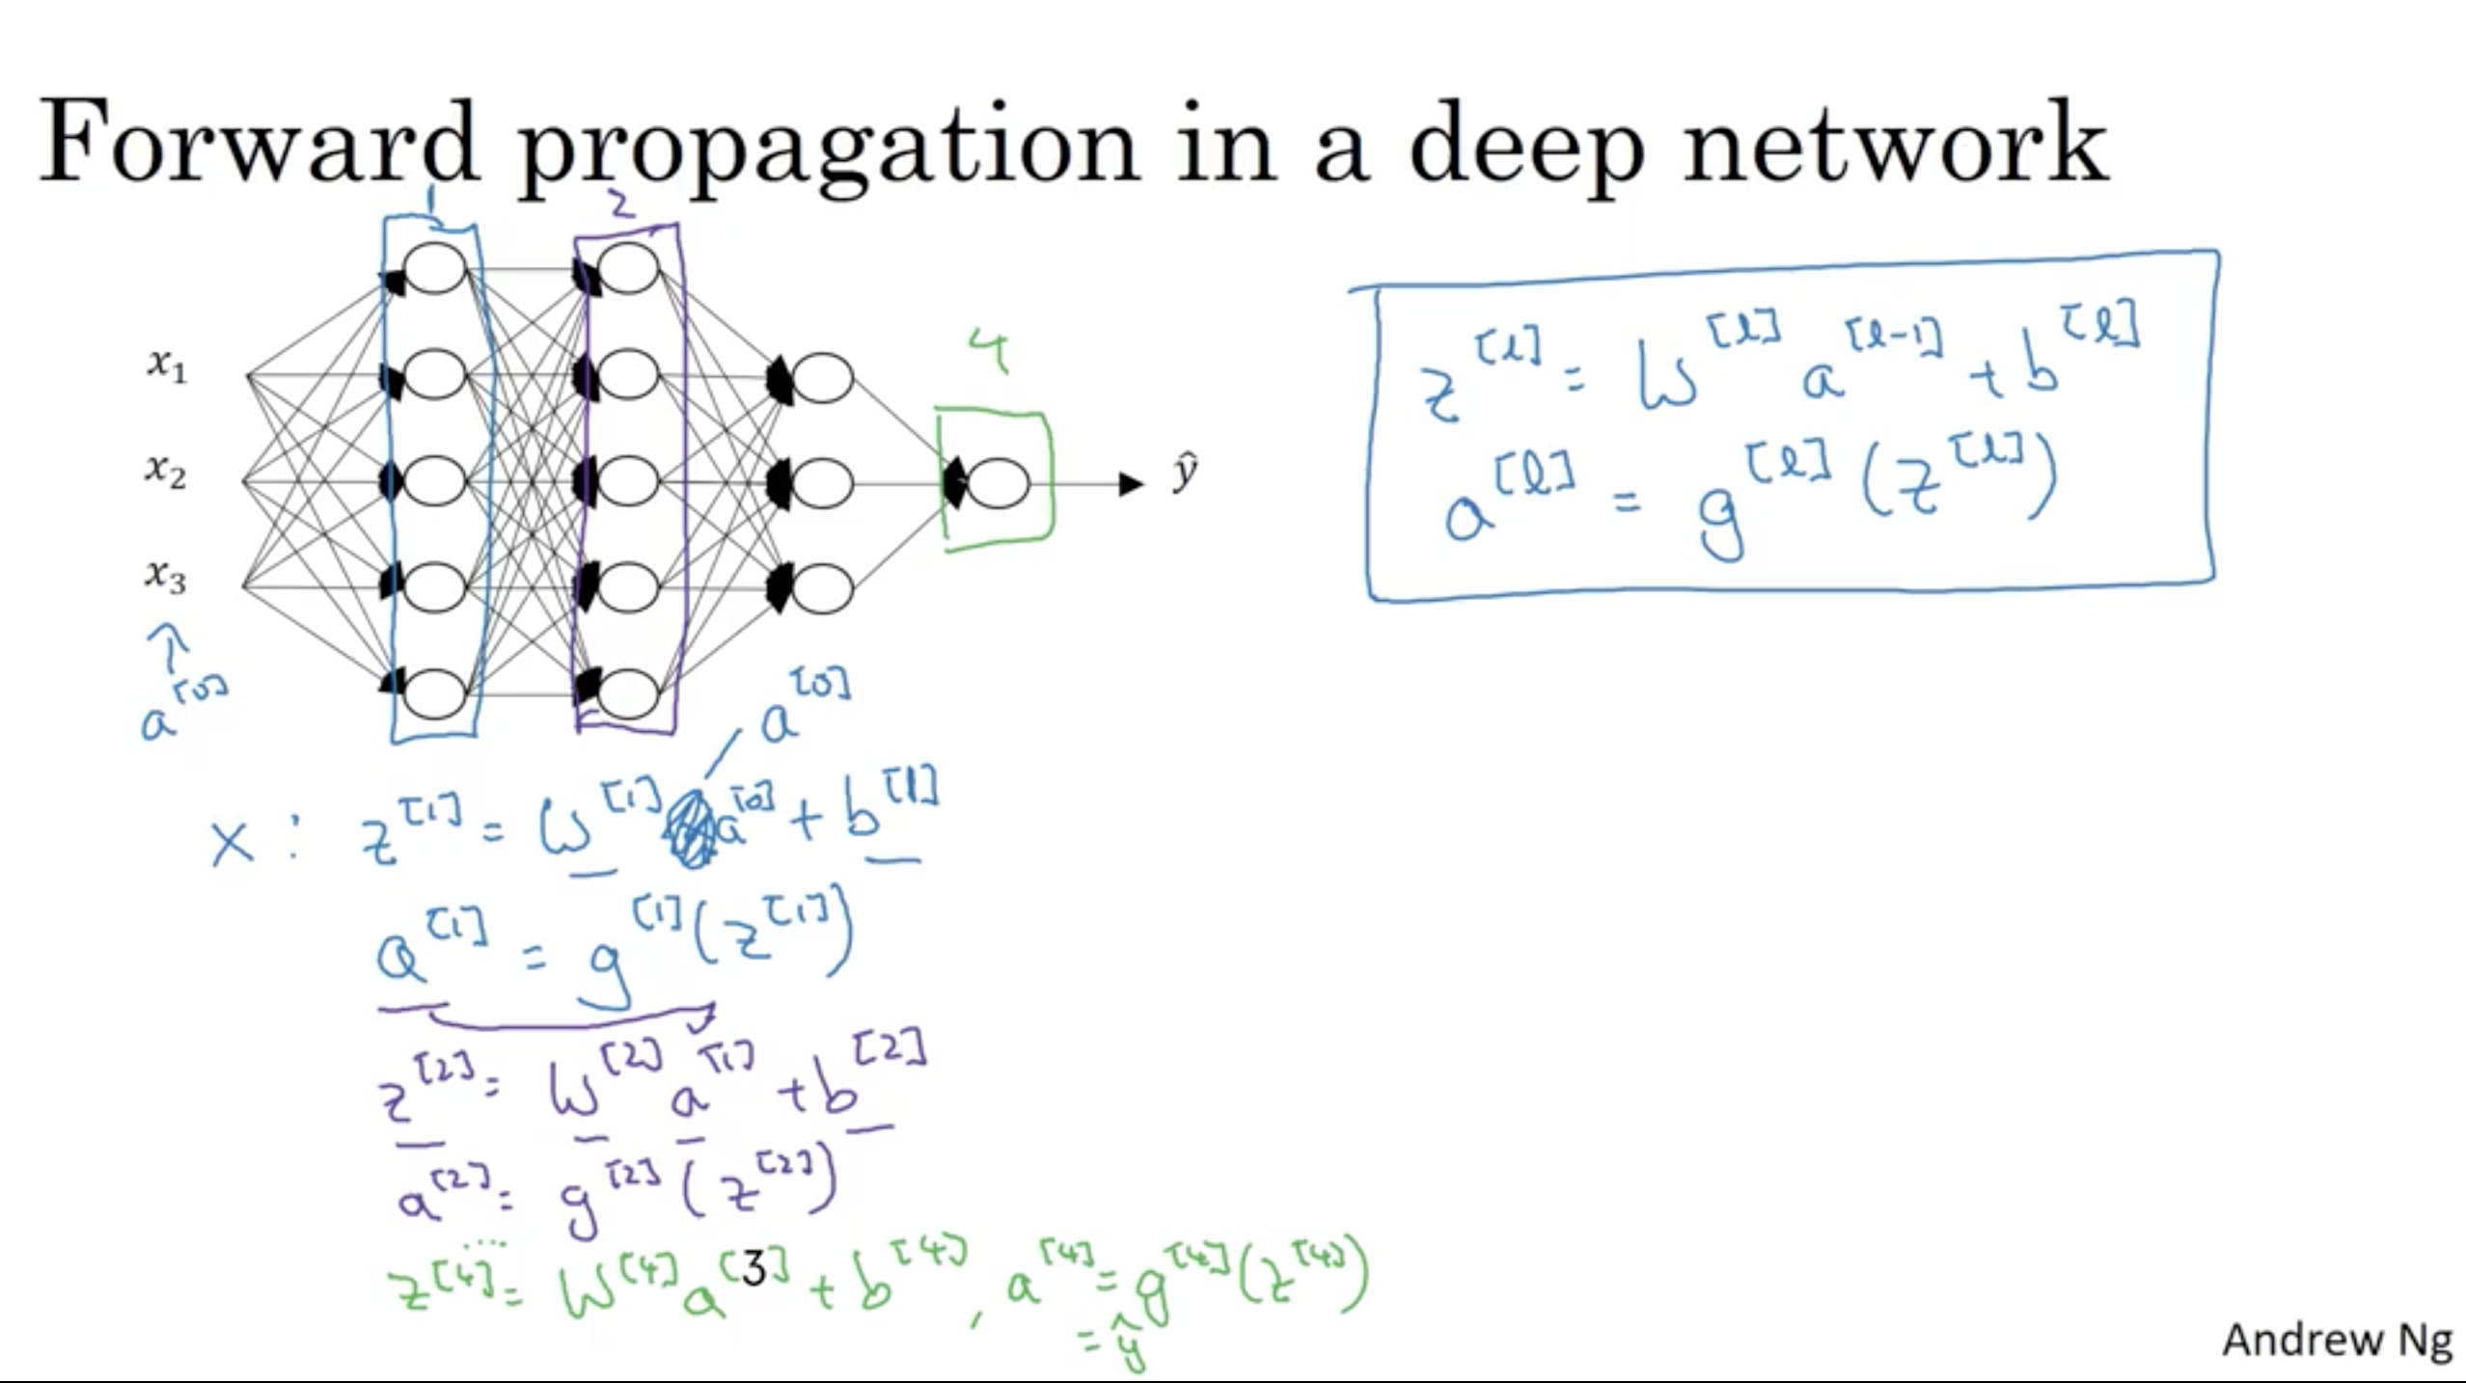

Slide 82
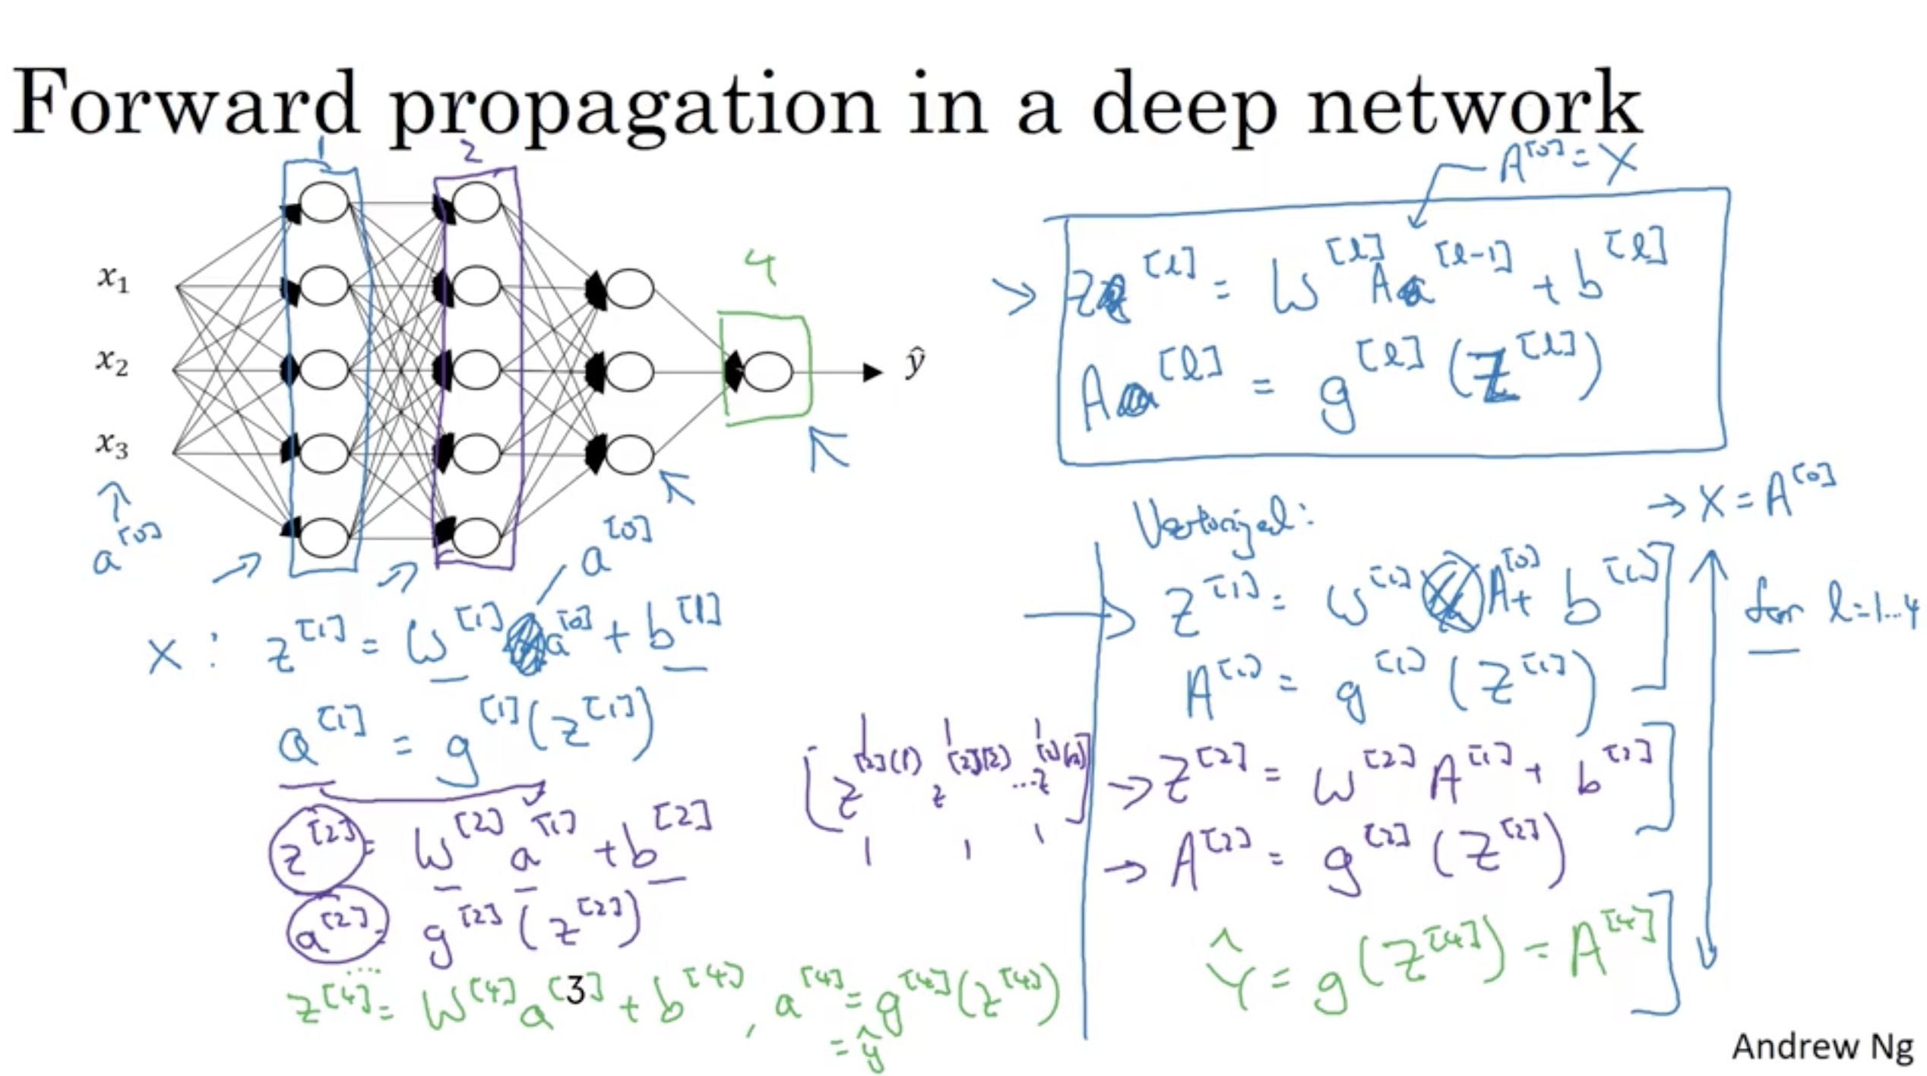

Slide 83
Deep Neural Networks
Why deep
representations?

Slide 84

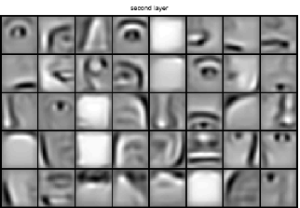
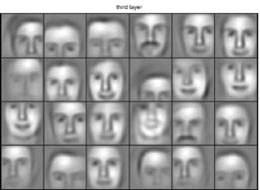
Intuition about deep representation
$$\hat{y}$$

Slide 85
Deep Neural Networks
Building blocks of
deep neural networks

Slide 86
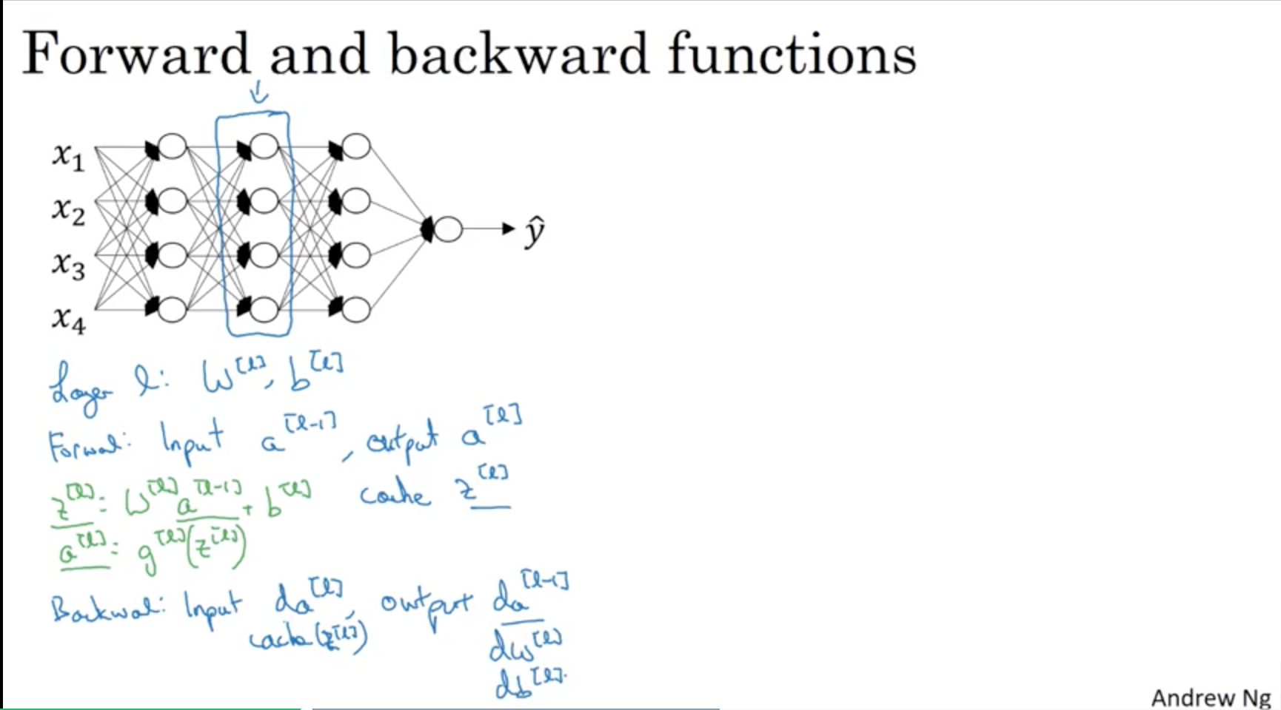

Slide 87
Forward and backward functions
$$x_{1}$$
$$x_{2}$$
$$\hat{y}$$
$$x_{3}$$
$$x_{4}$$

Slide 88
Forward and backward functions

Slide 89
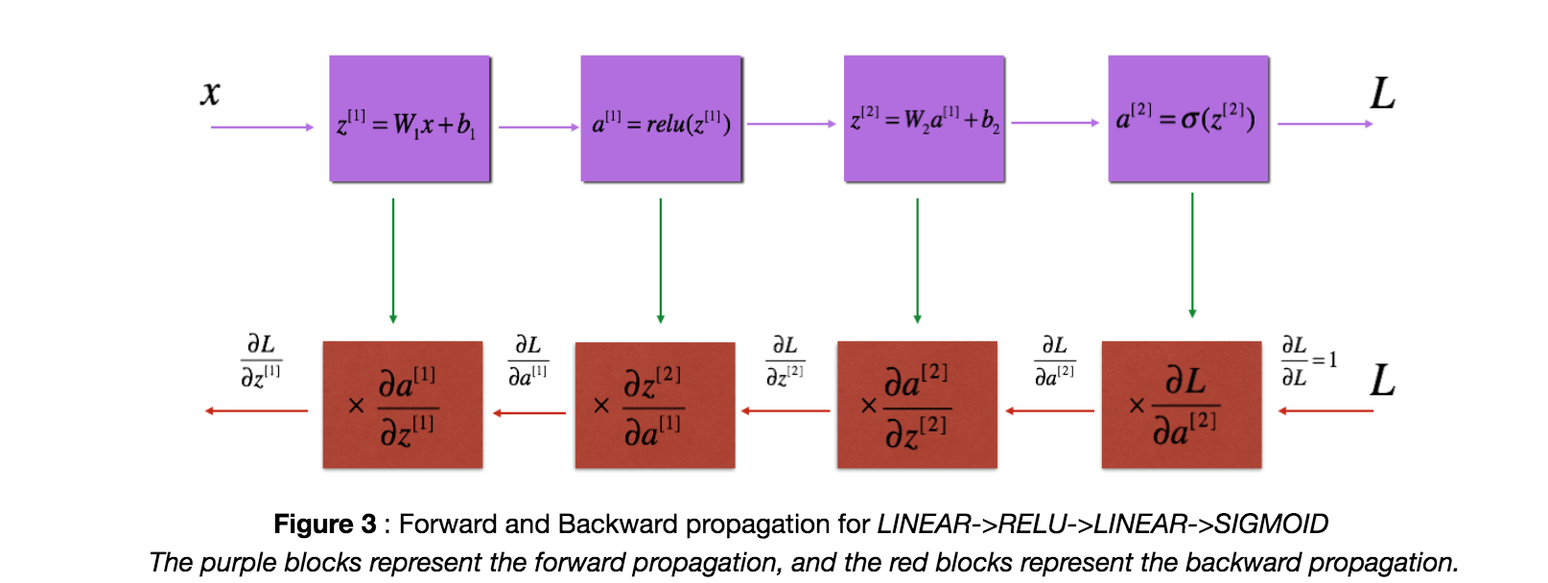
Summary

Slide 90
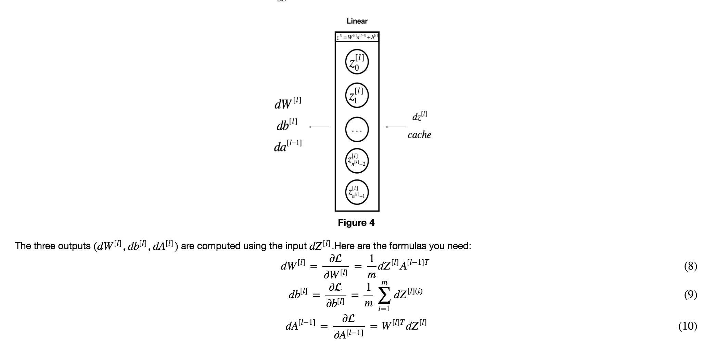
Summary

Slide 91
Deep Neural Networks
Parameters vs
Hyperparameters

Slide 92
What are hyperparameters?
Parameters: $W^{\left[1\right]} ,{ b}^{\left[1\right] }, W^{\left[2\right]} ,b^{\left[2\right] },W^{\left[3\right] }, b^{\left[3\right] }…$

Slide 93
Applied deep learning is a very empirical process
Idea
cost $J$
Experiment
Code
# of iterations

Slide 94
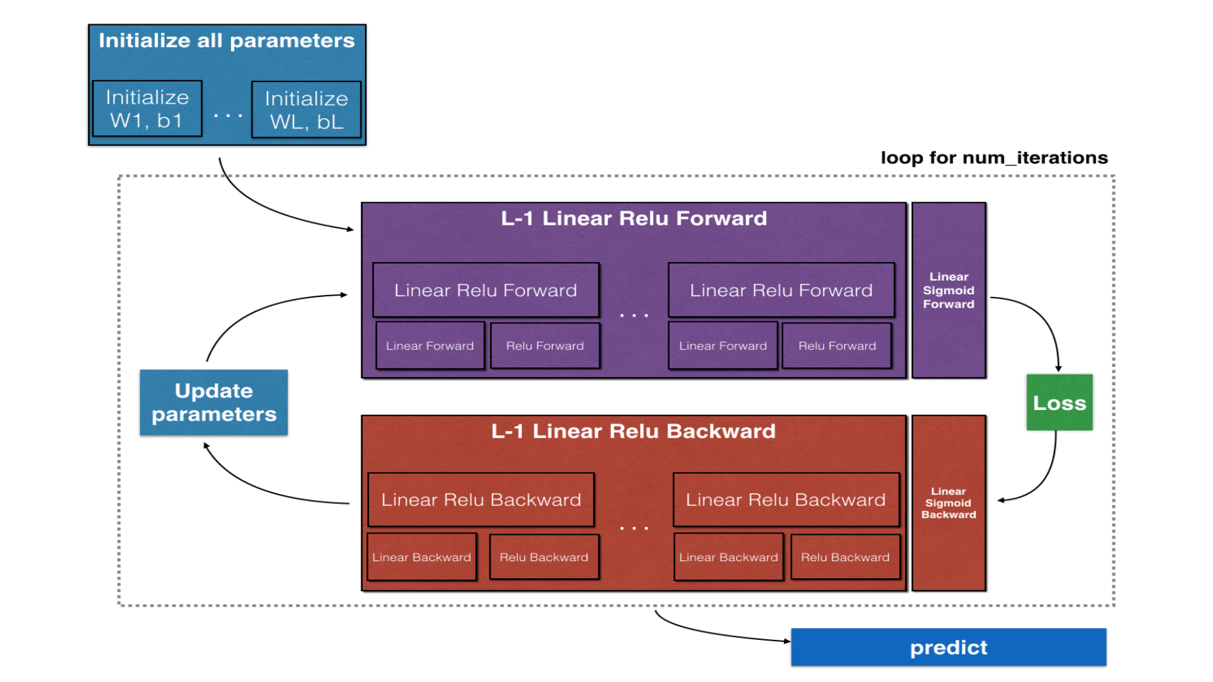
Summary

